Slide 1
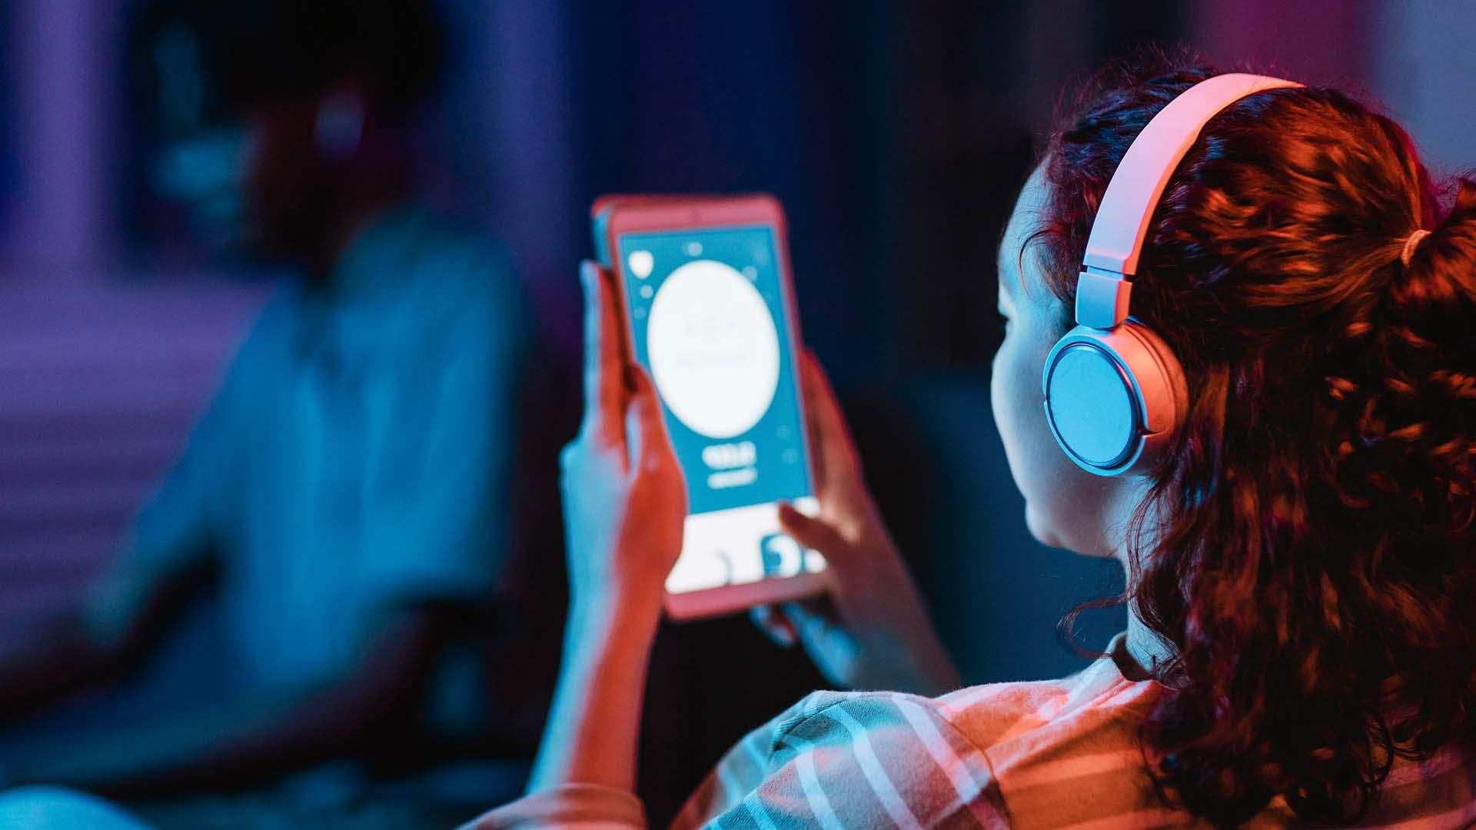
Predictive Screen Time Analysis for Healthier App Usage PHASE - 2 Methods, Findings and Recommendations
Nov 12th, 2024
Presenting by:
Pavan Boyapalli
Email: pb81497n@pace.edu
Practical data science, cs#667
MS in Data Science
Seidenberg School of CSIS
Pace University, NYC
1

Slide 2
AGENDA
EXECUTIVE SUMMARY
PROJECT PLAN RECAP
DATA
EXPLORATORY DATA ANALYSIS(EDA)
MODELLING METHOD
FINDINGS
RECOMMENDATION & NEXT STEPS
APPENDIX
2

Slide 3

EXECUTIVE SUMMARY
Business Problem: The problem statement for the screen time analysis revolves around the increasing concern over mobile app usage and its implications on user behavior, mental health, and productivity. As individuals become more reliant on mobile devices, there is a pressing need to understand how users interact with various applications, particularly in terms of the time spent, frequency of app openings, and the influence of notifications. This project seeks to analyze screen time data to identify patterns and trends in user engagement across different applications, elucidating the relationship between notifications and app usage.
Objective: The goal of the screen time analysis is to understand and predict user interactions with mobile apps to support healthier digital habits and improve well-being. By analyzing usage patterns—such as time spent, app frequency, and response to notifications—and applying machine learning, the project seeks to provide actionable insights for reducing excessive screen time. These insights will help app developers create more mindful experiences and offer recommendations for balanced app usage, promoting productivity and positive mental health in today’s digital world.
3

Slide 4
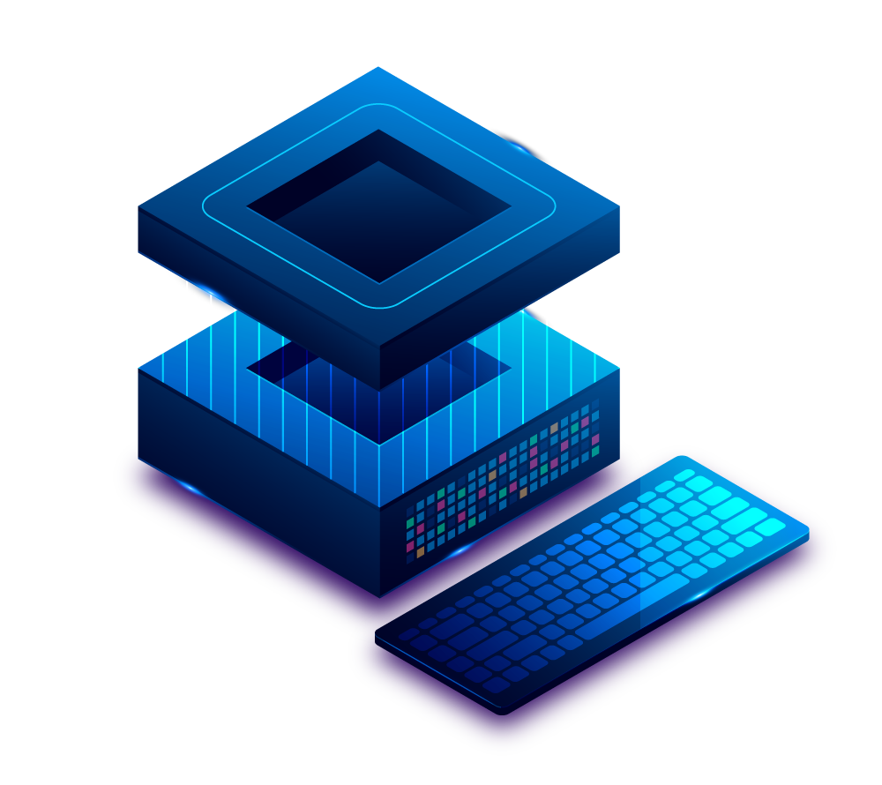
PLAN OF THE PROJECT
DELIVERABLE | DETAILS | DUE DATES | STATUS OF COMPLETION
DATA & EDA | Identify the patterns and trends in screen usage time. | 11-05-2024 | Completed
Methods and Findings, Recommendations | Find out the methods and draw recommendations | 11-12-2024 | Completed
Final Presentation | Final Completion Deck | 12-03-2024 | In Progress
4

Slide 5
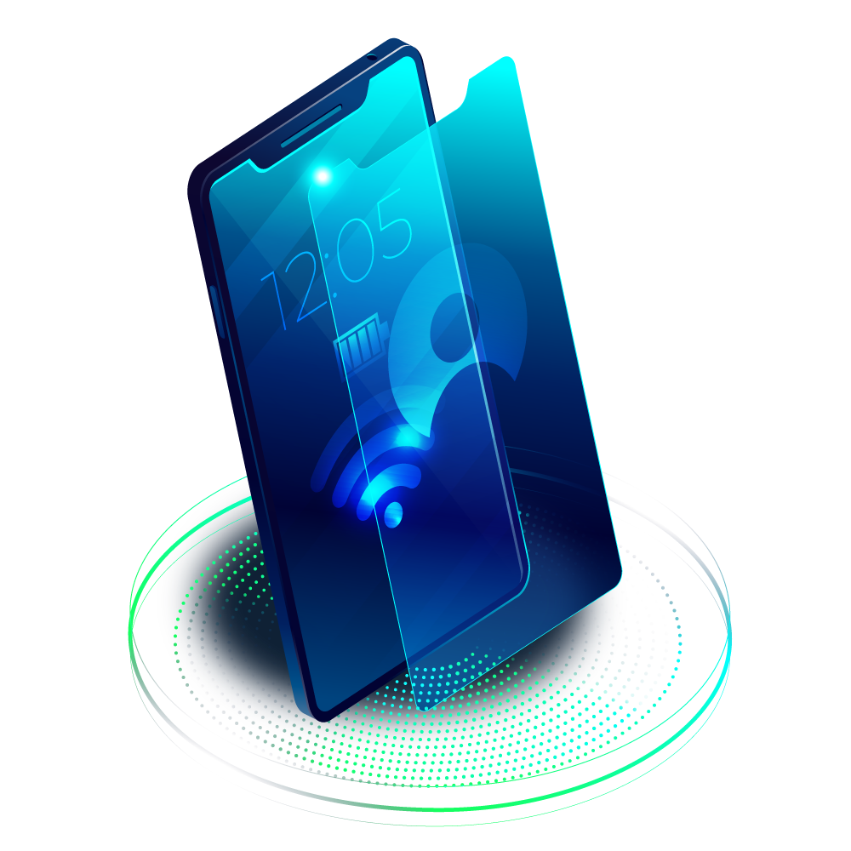

DATA
5

Slide 6

DATA
Source link :
https://www.kaggle.com/datasets/pavankumarreddyb/screen-time-analysis
Sample Size: 200
Time Period : August 2024
6

Slide 7
FEATURES
Usage (minutes)
Date
App
Notifications
02
04
Times Opened
It helps to track usage patterns over time
It provides insight into the user's engagement with the app.
Records the number of times the app was opened that day
03
01
05
It indicates the name of the application being used
Shows the number of notifications received from the app on that day.
7

Slide 8
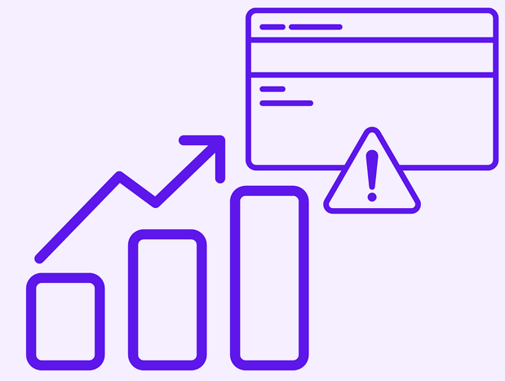
EXPLORATORY DATA ANALYSIS
8

Slide 9
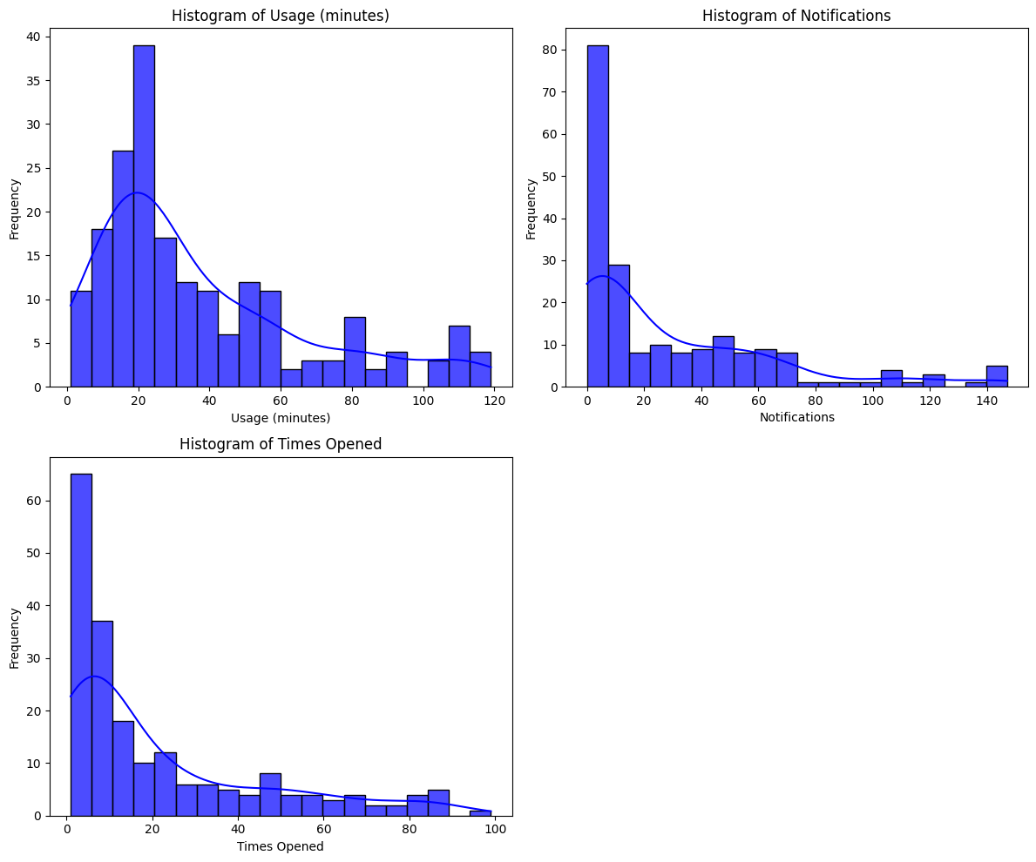
Understanding User Habits and Preferences
Usage Time: Most users have relatively short usage sessions, with the majority spending less than 40 minutes per session. A smaller group of users engages for significantly longer periods.
Notifications: The majority of users receive a moderate number of notifications, with fewer than 40 notifications being the norm. A smaller segment receives a higher number of notifications.
App Open Frequency: Users tend to open the app a moderate number of times, with a peak around 20-30 times. The distribution is relatively even, indicating consistent usage patterns.
9

Slide 10
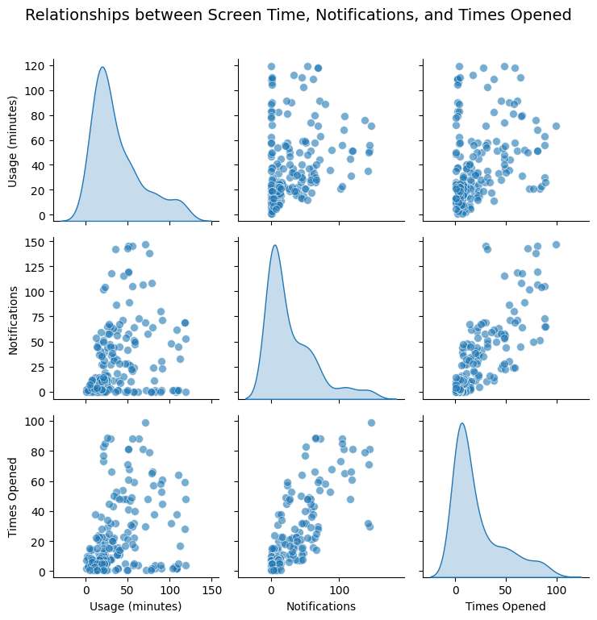
Relationships between Screen Time, Notifications and Times Opened
The pair plot shows relationships between screen time (usage in minutes), notifications, and times an app was opened. The scatter plots indicate a moderate positive correlation between notifications and times opened, as well as between times opened and usage minutes, which suggests that more notifications lead to more app usage and openings. However, the correlation between usage and notifications is weaker, showing that receiving many notifications does not always result in higher screen time. The histograms on the diagonal also show that most data points cluster around low values for usage, notifications, and times opened.
10

Slide 11
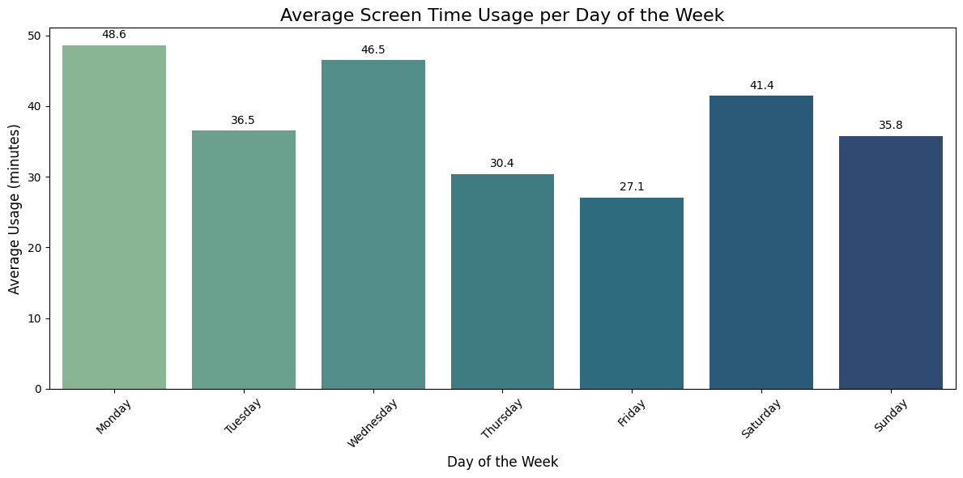
Weekly User Engagement Patterns
The highest usage occurs on Monday and Wednesday, which indicates that the beginning and middle of the week see the most screen time. Usage decreases towards the end of the week, with Friday having the lowest average. Screen time increases again on Saturday and slightly drops on Sunday. This pattern suggests higher screen engagement during workdays and moderate usage over the weekend.
11

Slide 12
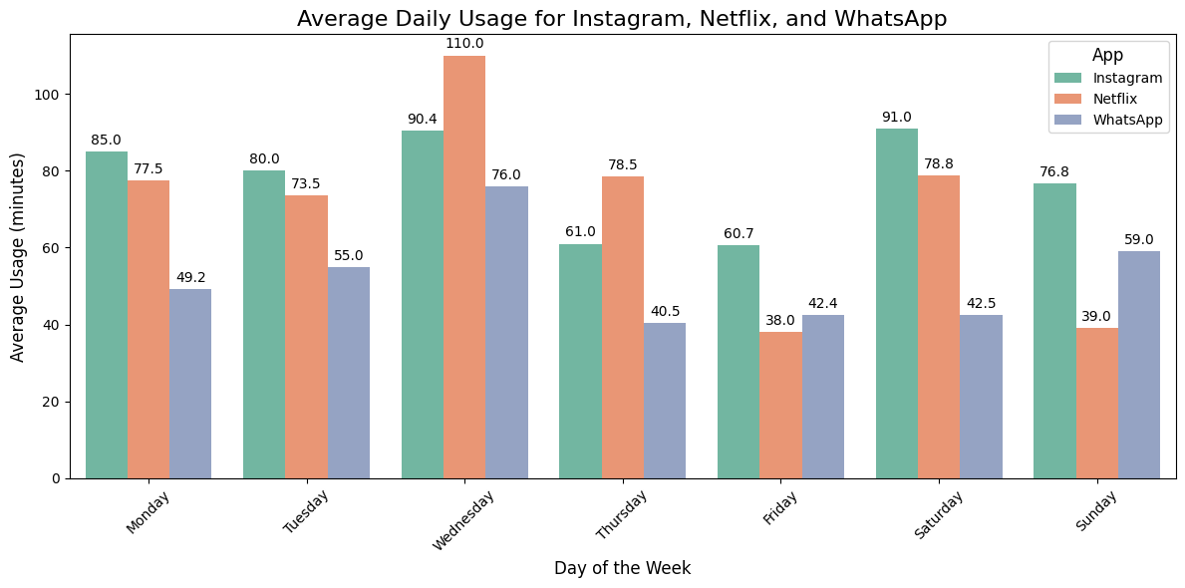
Identifying Peak Usage Days for Different Apps
Instagram consistently has the highest usage, especially on Saturday and Wednesday. Netflix usage peaks on Wednesday and Saturday, which shows strong mid-week and weekend engagement. WhatsApp usage is generally lower than Instagram and Netflix, with its highest usage on Sunday and Wednesday. Overall, Wednesday and Saturday are the days with the highest overall screen time across these three apps.
Netflix and Instagram have greater usage rates than WhatsApp. For example, Netflix is something we watch for a long, and Instagram is something we explore for a while, whereas WhatsApp is more transactional in that we open it to answer to a message and then close it. Unlike Netflix and Instagram, WhatsApp offers nothing to browse or spend more time doing.
12

Slide 13
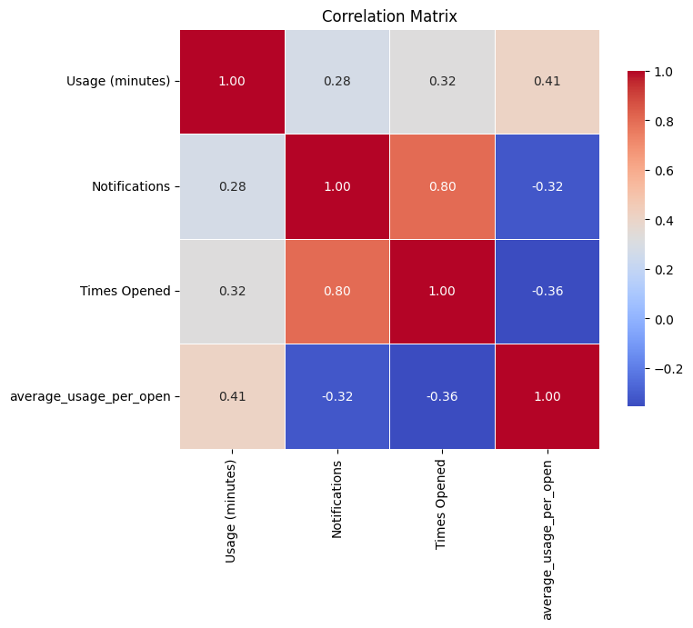
Relationships Between Key User Metrics
Strong Positive Correlation: A strong positive correlation exists between "Notifications" and "Times Opened" , suggesting that as the number of notifications increases, the frequency of app openings significantly rises.
Moderate Positive Correlation: There is a moderate positive correlation between "Times Opened" and "Usage (minutes) , indicating that more frequent app openings lead to longer usage durations, but the relationship is less pronounced than the previous one.
Weak Negative Correlation: A weak negative correlation exists between "Notifications" and "average usage per open" , implying that a higher number of notifications might lead to shorter individual usage sessions. This could be due to users quickly checking notifications and then closing the app.
Moderate Positive Correlation: A moderate positive correlation between "Usage (minutes)" and "average usage per open" , indicates that longer usage sessions are associated with longer average usage per session.
13

Slide 14
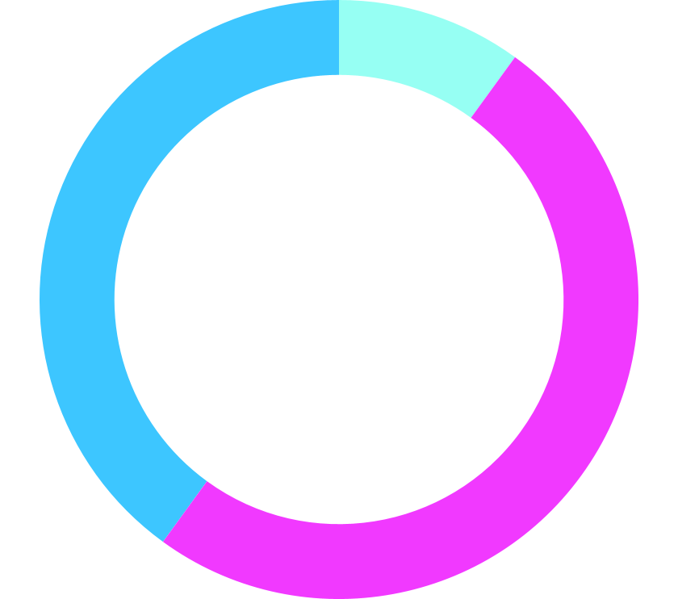
MODELING METHOD
14

Slide 15
MODELING
OUTCOME VARIABLE:
The primary outcome variable in our screen time analysis is Usage (minutes). This represents the total time users spend on mobile applications. Understanding this variable is crucial as it highlights user engagement levels and can indicate potential issues related to excessive screen time.
FEATURES:
We selected a combination of features that reflect user behavior and engagement with mobile apps.
Notifications: More notifications may lead to increased app usage.
Times Opened: Reflects user engagement and frequency of app interaction.
Is Weekend: Usage patterns may differ between weekdays and weekends.
Average Usage Per Open: Indicates how much time users spend each time they open an app.
These features help us understand user behavior and predict how likely they are to engage with an app.
Note: To know more about “Is Weekend” and “Average Usage Per Open” (Support Data)
15

Slide 16

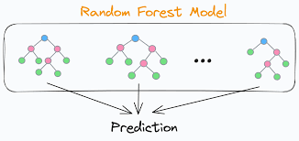
MODEL SELECTION: RANDOM FOREST
We are using a Random Forest Regressor model for our analysis. This model is like a team of decision-makers that collectively assess user data to make predictions.
Why Random Forest?
This model is effective because it can handle various types of data and interactions between features well. It’s effective for our case because:
It handles complex relationships between features.
It’s robust to overfitting, meaning it can generalize well to new data.
For more technical information refer this slide
16

Slide 17
FINDINGS
17

Slide 18
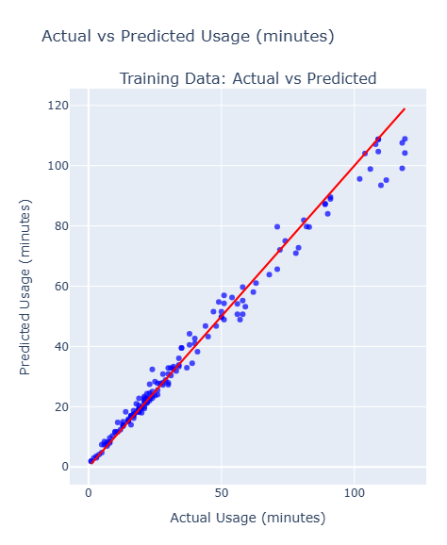
Model Performance and Predictions
Our model’s goal is to predict how much time users spend on apps based on factors like notifications and the frequency of app openings. To measure the model’s effectiveness, we tested its predictions on two sets of data: the data it trained on (training data) and a fresh set it hadn’t seen before (testing data).
Training Data Results
When we checked the model’s predictions against the actual app usage in the training data, we found that it was highly accurate, with predicted screen time closely matching the actual screen time. This tells us the model successfully learned the patterns in user behavior from this data.
18

Slide 19
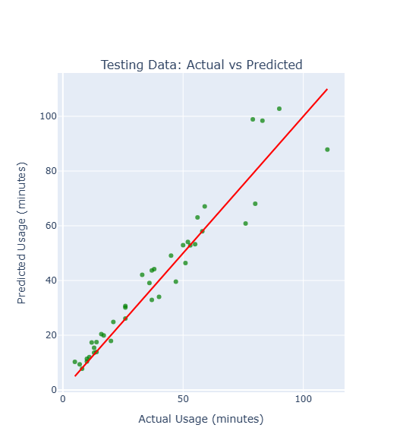
Model Performance and Predictions
Testing Data Results
For the testing data, which the model hadn’t seen before, the predictions were also very close to actual usage values. This accuracy on new data shows that the model can reliably predict app usage for new users or timeframes.
Overall, the model can effectively anticipate app screen time based on user behavior patterns. This means it’s a useful tool for making predictions about app usage and could help app developers understand and potentially influence healthier screen habits for users.
19

Slide 20
Understanding Digital Behavior
Our model demonstrates strong performance in predicting user segments (Light, Moderate, Heavy, Very Heavy) based on their usage data. By accurately identifying user segments, we can tailor interventions to address specific needs. For example, users with very heavy usage could be offered personalized recommendations to reduce screen time, while users with light usage could be encouraged to explore new content or features. (Supporting Data)
Our analysis reveals distinct patterns in weekly screen time usage. Notably, Monday and Wednesday exhibit the highest average screen time. To promote digital well-being, we can implement targeted interventions like mindfulness exercises during peak usage times and personalize recommendations for individual users. (See Details)
The findings shows that Instagram is consistently popular throughout the week, while Netflix usage peaks on weekends. WhatsApp is also used regularly. These insights can inform targeted advertising strategies, guide product development efforts, and improve user experience by optimizing app performance and personalization. (Related Insight)
20

Slide 21

RECOMMENDATIONS AND
NEXT STEPS
21

Slide 22
Recommendations for Supporting Healthier App Usage
1. Limit Non-Essential Notifications: Notifications are a strong driver of increased screen time, leading users to frequently re-engage with the app. The developers can provide an “Essentials Only” notification option, encouraging users to stay focused without constant interruptions. By prioritizing essential notifications and grouping less urgent ones can help users feel less overwhelmed and more focused, leading to a positive impact on app usage and user satisfaction.
2. Encourage Breaks During Extended Sessions: High usage is often due to prolonged, uninterrupted sessions, especially on weekends. Introducing gentle reminders to take breaks after a certain amount of continuous screen time. By encouraging breaks, the app can support healthier digital habits, helping users avoid burnout and maintain better balance in their app engagement.
3. Introduce Personalized Usage Reminders: Users with high notification and app open rates often engage frequently, leading to prolonged usage. To address this, we can implement personalized usage reminders, such as "You've been using [App] for 1 hour today." These reminders can empower users to make conscious choices about their screen time, fostering healthier digital habits and reducing excessive usage.
4. Develop an In-App Wellness Mode: Excessive screen time caused by frequent notifications can negatively impact user focus and mental health. To address this, we can introduce a "Wellness Mode" that allows users to limit notifications and receive gentle reminders to take breaks. This feature not only promotes a healthier digital lifestyle but also creates a more balanced and productive app experience for users.
22

Slide 23
Next Steps
Expand Data Collection for Comprehensive Analysis
To address broader business questions and gain a deeper understanding of user engagement, we will expand data collection to include user demographics, in-app activity types, and usage goals. By analyzing this enriched dataset, we can identify how specific content or features impact screen time across different user segments. This will enable us to provide more tailored recommendations and support balanced digital habits.
2. Explore More Advanced Modeling Techniques
To further improve predictive accuracy and gain deeper insights into user engagement patterns, we will experiment with more advanced models like gradient boosting or neural networks. These models are designed to capture complex, non-linear relationships between user behavior and screen time, ultimately enhancing the model's ability to predict delicate patterns.
3. Iterate and Fine-Tune
Fine-tune the model by adjusting hyperparameters, exploring different architectures, or employing regularization techniques. Repeat the retraining and evaluation process until the model achieves the desired performance and effectively addresses the business problem.
23

Slide 24
APPENDIX
Venus
24

Slide 25
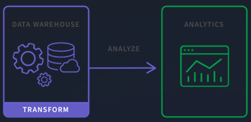
DATA TRANSFORMATION
Date Conversion:
The Date column, initially in string format, is converted to a datetime format. This allows for easier manipulation and analysis based on time.
Feature Engineering
Creating Day of the Week Feature:
A new feature, Day of Week, is created by extracting the day name from the Date column. This allows for analysis of screen time trends based on the day of the week.
Is Weekend Feature:
An additional binary feature, Is Weekend, is created to indicate whether a given day is a weekend (Saturday or Sunday).This feature helps to analyze usage patterns specifically on weekends versus weekdays.
Average Usage Per Open:
A new metric, average usage per open, is calculated by dividing Usage (minutes) by Times Opened. This feature provides insight into user engagement, indicating how much time is spent on average each time an app is opened.
25

Slide 26
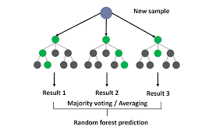
MODEL TYPE : RANDOM FOREST
We are using a Random Forest Regressor model for our analysis.
The Random Forest Regressor is an ensemble learning method that constructs multiple decision trees during training and outputs the average prediction (for regression tasks). Key advantages include:
Handling Non-linearity: It captures complex relationships between features without requiring them to be linear.
Feature Importance: The model provides insights into which features are most influential in predicting app usage.
Robustness to Overfitting: By averaging the results from multiple trees, it mitigates the risk of overfitting on training data.
Model Evaluation Metrics
We assess model performance using metrics like Mean Absolute Error (MAE) and R² Score, which indicate the accuracy of our predictions and the proportion of variance explained by the model.
The model was tuned by using GridSearchCV and model showed strong performance metrics R² of 0.92, indicating it effectively captures the relationship between features and screen time.​
26

Slide 27
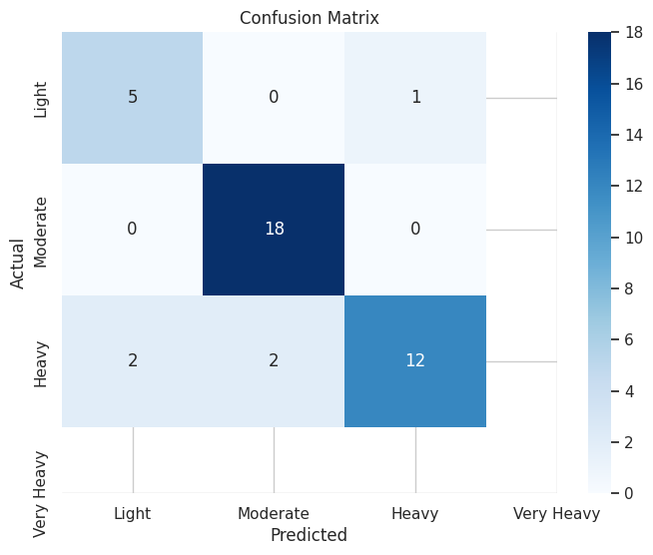
Confusion Matrix
Overall Performance:
The model seems to be performing well in predicting the "Moderate" class, as indicated by the large value (18) on the diagonal. However, it struggles with the "Heavy" class, as seen by the low values on the diagonal for this class.
The model tends to overpredict the "Very Heavy" class, as there are more instances where it predicts "Very Heavy" when the actual class is "Heavy".
Potential Issues:
The model seems to have difficulty distinguishing between "Heavy" and "Very Heavy" classes.
27

Slide 28
THANK YOU
28

